Slide 1
Good Morning

Slide 2

What Is The Smart Shop???

Slide 3

Smart Shop
Smart Shop Is a Online Get Scratch Card Shop Like As Communication.
You Can Buy scratch card on your phone.
Fully Secured And Easy steps.
You can pay your payments using PAYPAL
This is the srilankan’s first online shop in stored Scratch card.

Slide 4
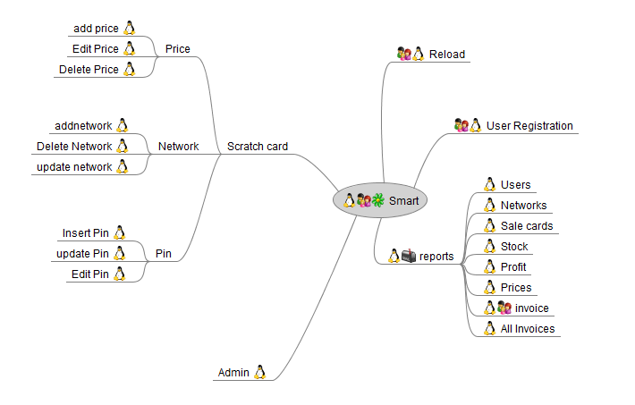
Mind Map

Slide 5
Application
Web Application
Standalone Application
User+Admin
Fully Admin
Get Scratch Card Get Reload
Admin Activities

Slide 6
Features
Fully Secured
Email Sending
Easy Login
Connect PayPal
Admin Can manage His App on SE or EE App
User Friendly
Etc: (Reload & Get Scratch Card)

Slide 7
Up coming Subprojects In Smart
Update Version in Smart Web App And SE App
After Fix the Reload Panel, search Bar And Customer Comments
For Mobile
Android & J2ME App For Admin And User

